Slide 1


KING COUNTY HOUSE HUNTERS
BY TIMOTHY CUMMINS, HAMZA MASOOD AND MIHIR BHAGAT

Slide 2


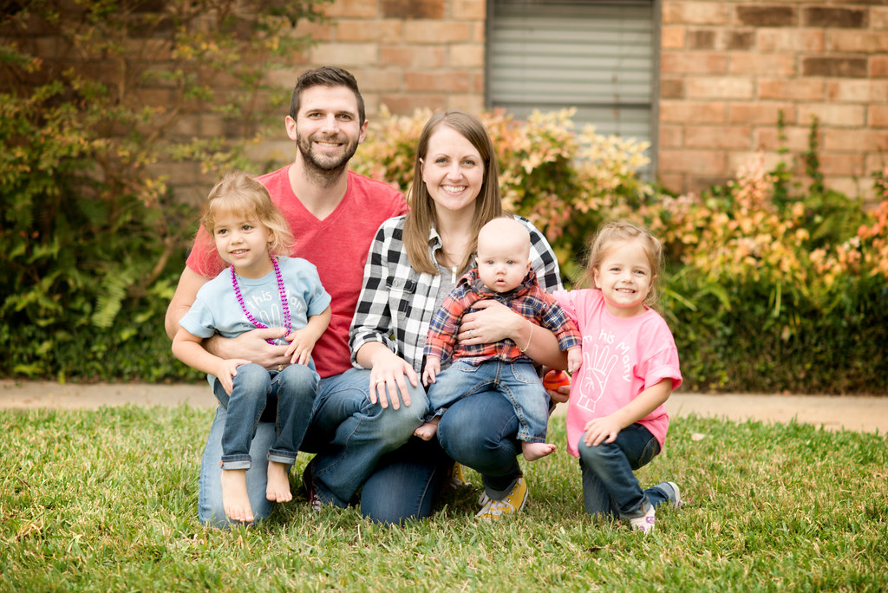
PROJECT GOAL: PREDICT HOME SALE PRICE
DATA INCLUDED
LOCATION
YEAR BUILT/RENOVATED
BUILDING GRADE
HOME SIZE (SQ. FOOTAGE, BEDROOMS, ETC.)
NUISANCES
VIEW
WATERFRONT
TARGET AUDIENCE
This Photo by Unknown Author is licensed under CC BY

Slide 3
OUR PROCESS
DESIGN = SQL/PANDAS, BREAK DOWN BY ZIP CODE, LINEAR REGRESSION
LIMITATIONS = NO LUXURY HOME FEATURES, RENOVATION DATA
ASSUMPTIONS = PROPERTY TYPE, NUISANCE, ELIMINATED OUTLIERS :

Slide 4

BASELINE MODEL
BIGGER IS BETTER
$ $ $ $ $ $ $

Slide 5
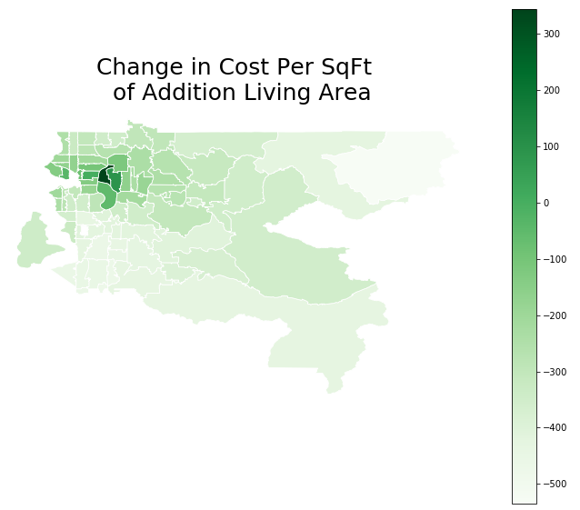
LOCATION LOCATION location
FINAL MODEL

Slide 7
MAKE YOUR CLAIM
IMPACTFUL FACTORS (RANKED)
SQUARE FOOTAGE
COST PER SQUARE FOOT
WATERFRONT
LOT PROPORTION
PORCH
NUISANCE

Slide 8

NEXT STEPS
EXPLORE SEATTLE GROWTH
COMPARE OTHER HOT REAL ESTATE MARKETS (AUSTIN, DENVER, ETC.)
HOME PRICE VS. GROWTH OF AMAZON
PREDICT GENTRIFICATION OF SUBURBS (EX. BROOKLYN IN NYC)
POTENTIAL PROBLEM: AVAILABILITY OF LOW-INCOME HOUSING
FURTHER ANALYSIS
RENOVATIONS OF SAME PROPERTY OVER TIME
WHICH SEASON SELLS THE MOST HOMES?
IMPACT OF CRIME DATA

Slide 9
QUESTIONS?

